Slide 1
Pathophysiology and Therapeutics: Inflammatory Bowel Disease
Lawrence Carey, PharmD
Temple University School of Pharmacy

Slide 2
Objectives
Describe the difference in disease distribution and pathophysiological findings between Crohn’s disease and ulcerative colitis
Characterize major complications and their management in IBD
Recommend pharmacological therapy for the acute management and maintenance stage of IBD
Design an appropriate monitoring plan with regard to efficacy and toxicity of agents used to treat IBD
Notes:
400

Slide 3
Inflammatory Bowel Disease (IBD)
Two major entities:
Ulcerative colitis
Mucosal/submucosal inflammation
Confined to rectum and colon
Continuous lesions
Crohn’s Disease
Transmural inflammation
Any part of GIT
Can see fistulas, perforations, strictures
“Skipping”, discontinuous lesions
Hemstreet BA. In Pharmacotherapy, 8th edition, 2011.
Notes:
530

Slide 4
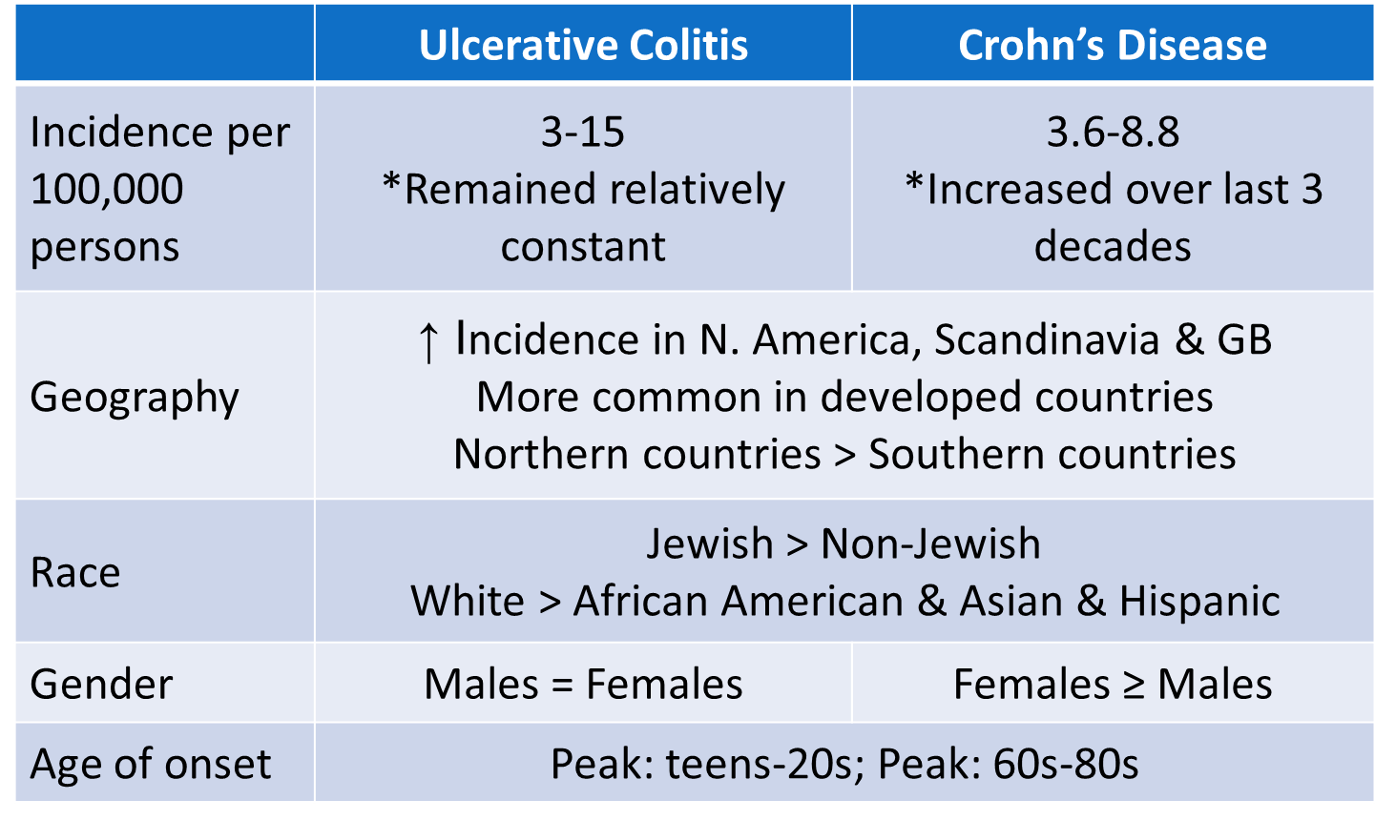
Epidemiology
Notes:
1200
GB = great britain

Slide 5
Etiology: Unknown
Combination of factors
Genetic: first degree relatives 20x more likely
Immunologic: TNF-alpha, inflammatory mediators
Infectious: tolerance to normal flora
Stressors:
Environmental: smoking (CD only), NSAIDs
Psychological (anxiety)
BOTTOM LINE:
Dysregulation of mucosal immune system → inflammation and ulceration
Notes:
1340

Slide 6
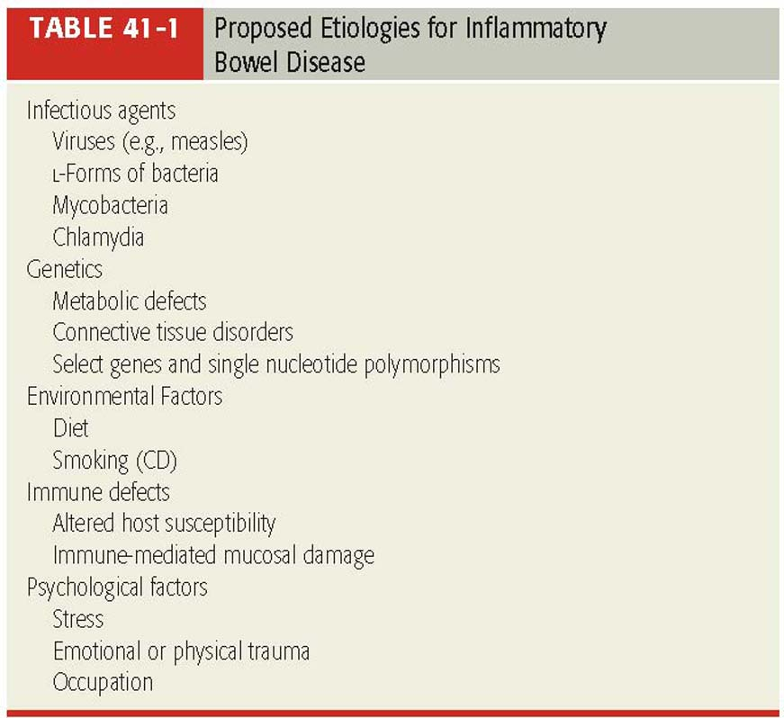
IBD: Etiologies
Hemstreet BA. In Pharmacotherapy, 8th edition, 2011.

Slide 7
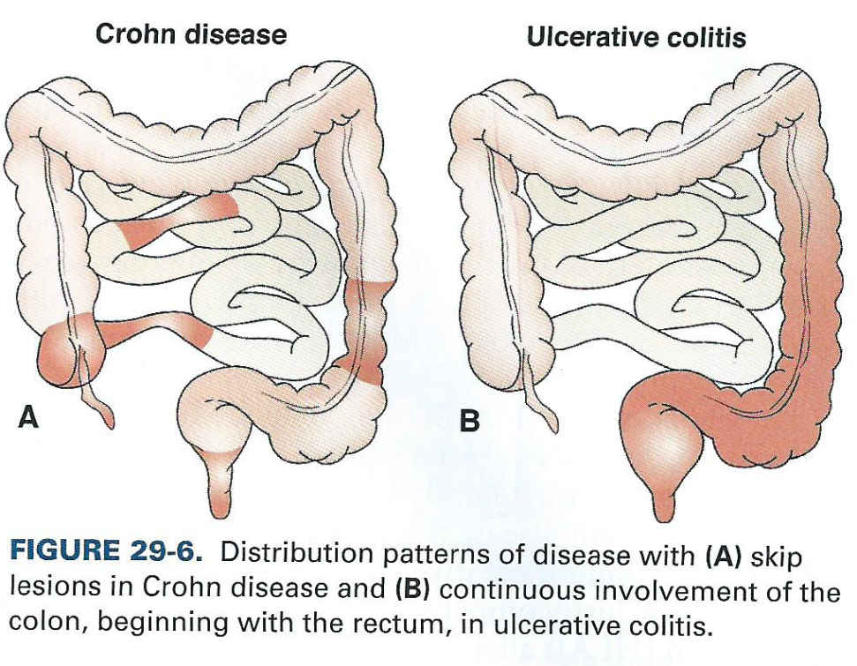
IBD: Pathophysiology
Ulcerative colitis and Crohn’s disease differ in two major respects:
Anatomical site affected
Depth of involvement within the bowel wall
A small percentage of patients may exhibit symptoms of both diseases
Porth CM. In Essentials of Pathophysiology, 3rd edition, 2011.
Notes:
1910

Slide 8
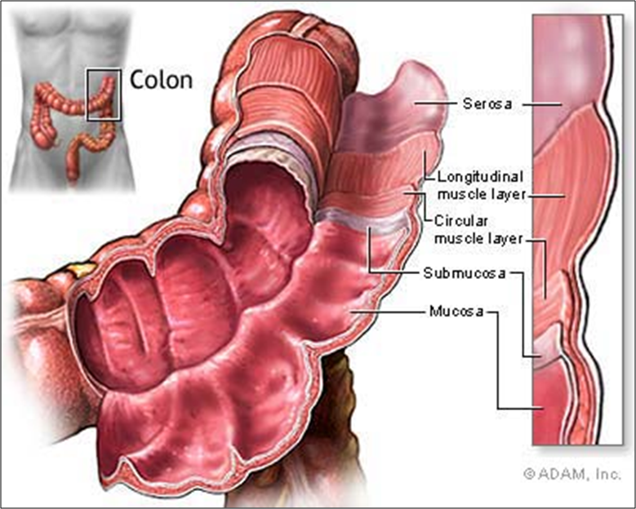
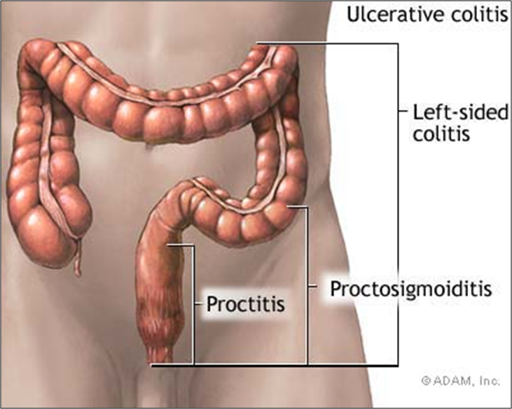
UC: Pathophysiology
Shallow lesions, affecting the mucosa and submucosa layers of intestine
These are the two innermost layers
Confined to the rectum and colon
Typically begins in the rectum and extends continually to the left colon
May involve the entire colon = “pancolitis”
Rectum only = “proctitis”
Notes:
2040

Slide 9
UC: Pathophysiology
Primary lesions occur in the crypts of the mucosa in the form of abscesses, ulcerations and necrosis of epithelium
Edema, hemorrhage, and surrounding accumulation of inflammatory cells are also present
Continuous disease; no “skip” areas
Notes:
23:00

Slide 10
UC: Symptoms
Typical:
Abdominal pain and cramping
Chronic, loose, bloody stools
Excessive mucus in bowel movements
Frequent/urgent need to defecate
Atypical
Fistulas, fissures
Relapse and remission are common
Up to 70% relapse within 1st year
Wall GC. In Applied Therapeutics, 10th edition, 2013.
Notes:
2745

Slide 11
UC Severity Classification
Classification | Stools/day | Systemic Toxicities | Labs
Mild | < 4 (+/- blood) | None | Normal erythrocyte sedimentation rate (ESR) of 0-20 mm/h
Moderate | > 4 (+/- blood) | Minimal | Normal or mildly elevated ESR
Severe | > 6 (bloody) | Fever, tachycardia, anemia | ESR > 30 mm/h
Fulminant | > 10 (continuously bloody) | As above, with abdominal tenderness, transfusion needs, colonic dilation on abdominal film | ESR > 30 mm/h Kornbluth A et al. Am J Gastrol 2010; 105:500.

Slide 12
Crohn’s: Pathophysiology
Transmural inflammatory process
Extends through all layers of the intestinal wall
May occur in any part of GIT
Terminal ileum most common site
2/3 have colonic involvement
15-25% have isolated colonic involvement
Discontinuous disease or “patchy”
Normal bowel separates areas of disease
Contains “skip areas”
Notes:
34:40

Slide 13
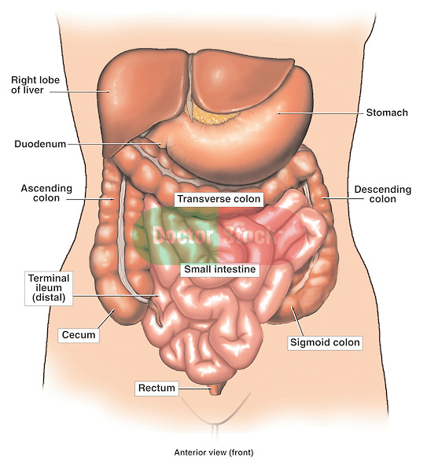

Slide 14
Crohn’s: Pathophysiology
Ulcers are deep, extending to the submucosa at minimum
4 layers could be involved from inner-to-outer
Mucosa, submucosa, muscularis propria, adventitia
Mesentery becomes thick, edematous, fibrotic, inflexible
“Garden hose” or cobblestone appearance
Relapse/remission common
20% have relapses every year

Slide 15
Crohn’s: Pathophysiology
Three patterns of disease:
Inflammatory
Stricturing: narrowing
Fistulizing: development of “communications”
Fistula development
Lifetime risk: 20-40%
Enterocutaneous (bowel → skin) most common
Perianal involvement common
Notes:
40:40

Slide 16
Crohn’s: Symptoms
Typical:
Chronic or nocturnal diarrhea
Abdominal pain
Weight loss, anorexia, malaise
Fever
Perianal fissure, fistula, abscess, abdominal masses
Intestinal obstruction, stricture
Rectal bleeding (may be present)
Frequent association with systemic symptoms involving the skin or joints

Slide 17
Crohn’s: Severity Classification
Classification | Findings
Mild to Moderate | Patients are ambulatory; able to tolerate oral feeds
Moderate to Severe | Presence of fever, pain, N/V, weight loss, anemia Failed treatment of of mild/moderate disease
Severe to Fulminant | Persistent symptoms despite treatment with induction agents Severe toxicity: high fevers, persistent vomiting, obstruction, cachexia, abscess development
Notes:
43:33

Slide 18
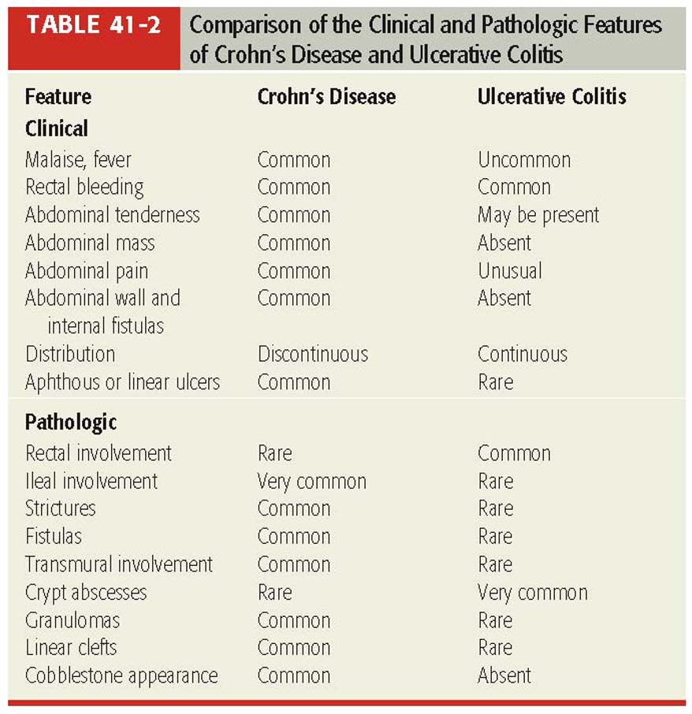
CD versus UC: Summary of Differences Hemstreet BA. In Pharmacotherapy, 8th edition, 2011
.
Notes:
45:00

Slide 19
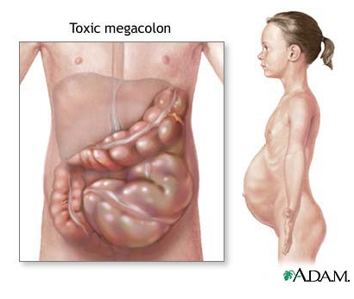
IBD Complications
Ulcerative Colitis:
Toxic megacolon
An acute dilatation of the colon due to loss of muscle tone, with associated systemic toxicity and shock
Associated symptoms: fever, tachycardia, distended abdomen, leukocytosis, abdominal tenderness, hypotension
Complications include perforation and hemorrhage
Occurs in 7.9% of UC patients
Death rate up to 50%
http://www.umm.edu/patiented/articles/toxic_megacolon_000215.htm
Notes:
46:40

Slide 20
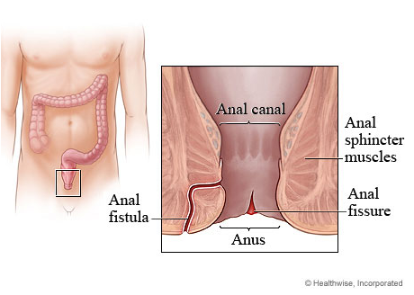
IBD Complications
Crohn’s Disease:
Obstruction
Fissures
Fistulas
Malabsorption leading to nutritional deficiencies
Weight loss 40-80%
Fe+ deficiency anemia 25-50%
B12 deficiency 20-37%
Osteomalacia 36%
Hypoalbuminemia 25-76%
http://www.webmd.com/digestive-disorders/anal-fissure-and-fistula
Notes:
49:50

Slide 21
IBD Complications
Colon cancer risk: UC >> CD:
Risk of colonic carcinoma is greatly increased in patients with UC
Risk is related to the extent of intestinal involvement and duration of disease
Risk begins to increase ~10 years after initial diagnosis
Absolute risk = 30% @ 35 years after diagnosis
Cancers are usually multiple, broadly-infiltrating, and occur at a younger age
Colonoscopy q 6-12 months to detect early areas of dysplasia

Slide 22
IBD: Complications Outside GIT
Liver disease
Primary sclerosing cholangitis, cholangiocarcinoma
Fatty liver, hepatitis, cirrhosis
Ocular inflammation
Iritis, scleritis, uveitis
Dermatologic
Erythema nodosum and pyoderma gangrenosum
Joint complications
Arthritis, ankylosing spondylitis

Slide 23
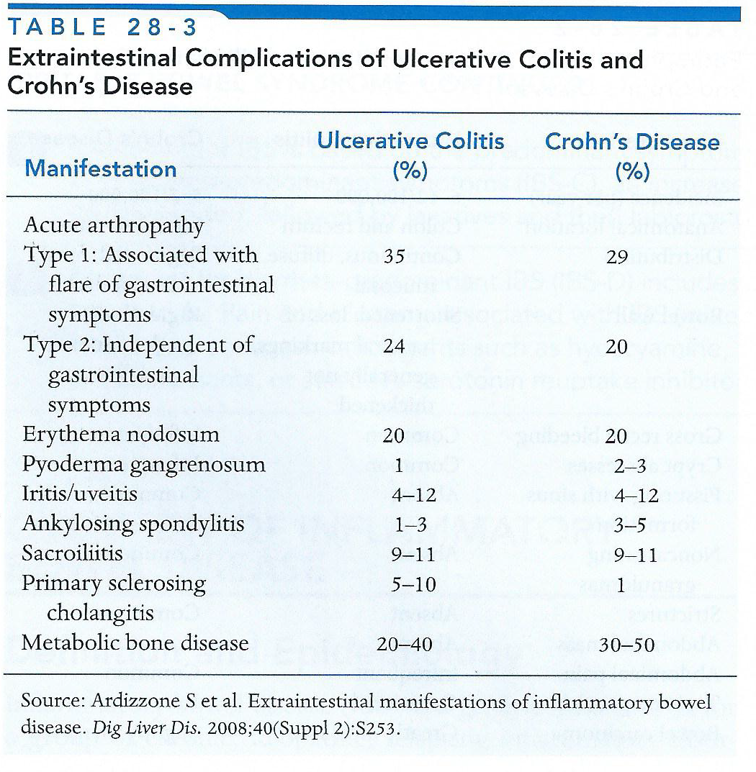
IBD Extraintestinal Complications Wall GC. In Applied Therapeutics, 10th edition, 2013.

Slide 24
Case
JM is a 25 yo c/o of watery diarrhea, moderate abd pain
5-10 stools/day , with ↑ frequency and urgency “to go”
From 3 days ago, notices bright red blood in her stool
She also has swelling, warmth, tenderness of her left knee
VS: T 99.5 BP 112/82 HR 100 RR 14
Labs: H/H: 8.5/32 WBC: 15,000 ESR: 70
Colonoscopy:
Continuous ulcerations
Erythema extending from anus through colon
No evidence of fissure or fistula

Slide 25
Case Answers
Cause of diarrheal disease?
Classify disease?
Treatment recommendations?

Slide 26
Management/Treatment of IBD

Slide 27
IBD Therapeutic Goals
Improve disease symptoms (induction and maintenance of remission)
Maintain adequate nutritional status
Improve quality of life
Relieve intestinal inflammation, dysfunction, and the development of cancer
Reduce the need for surgery &/or chronic corticosteroid use

Slide 28
How Do I Choose?
Disease State
Ulcerative colitis
Crohn’s disease
Disease Location
Rectum, colon
Small intestine
Extraintestinal manifestations
Disease Severity
Mild
Moderate
Severe
Categorizes severity & complications
Defines useful medications
Dictates treatment aggressiveness

Slide 29
IBD Drug Categories
Aminosalicylates
Corticosteroids
Immunosuppressants
Antimicrobials
Anti-TNFα agents
Adjunctives:
Loperamide (Imodium®): use with care; ↑ risk of TM
Antispasmodics
Dicyclomine (Bentyl®), propantheline, hyoscyamine

Slide 30
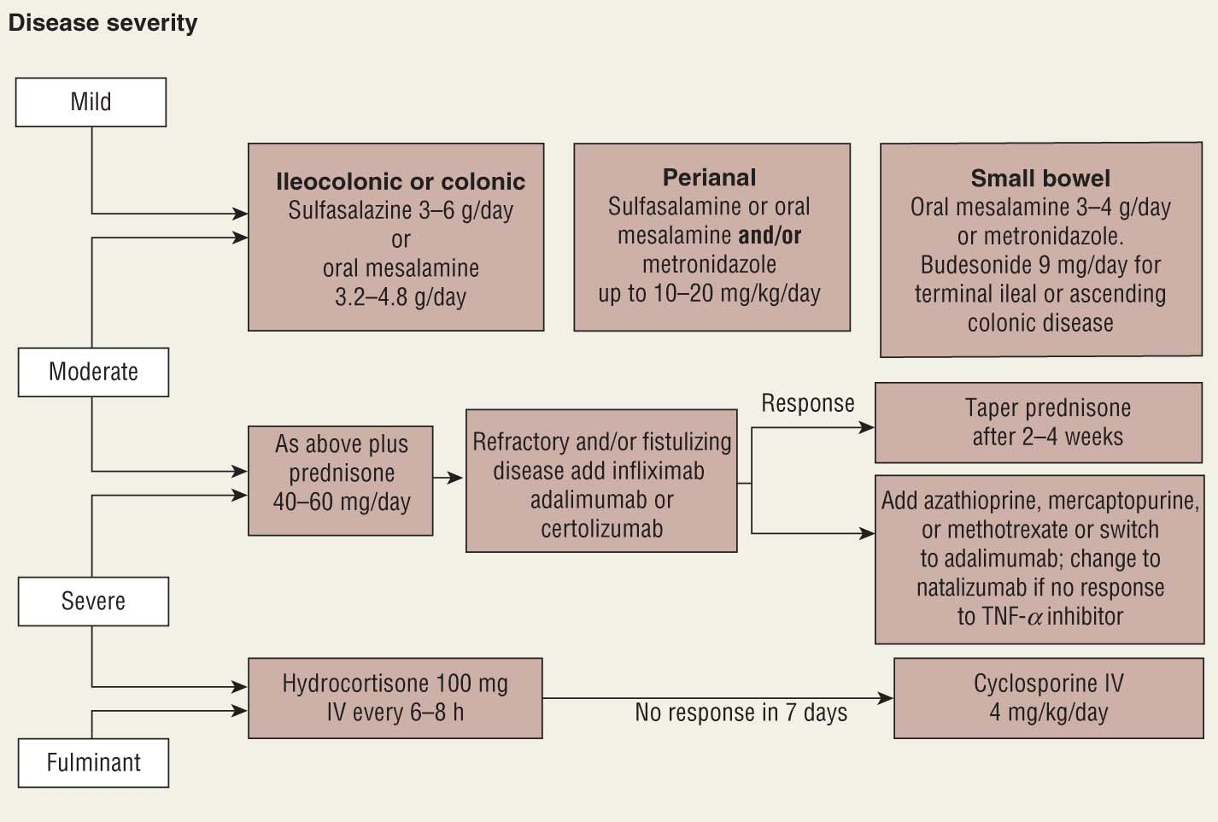
CD Treatment Algorithm Hemstreet BA. In Pharmacotherapy, 8th edition, 2011.

Slide 31
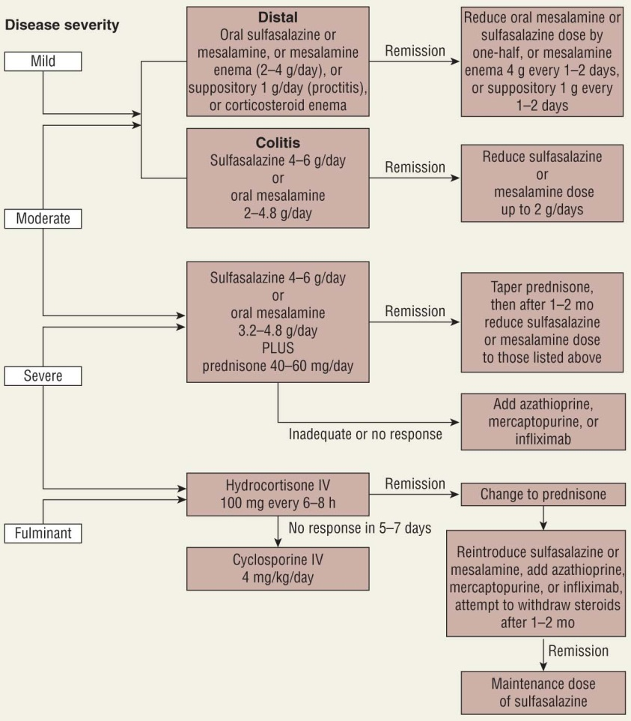
UC Treatment Algorithm Hemstreet BA. In Pharmacotherapy, 8th edition, 2011.

Slide 32
Aminosalicylates
Most common agents used in IBD
Considered first-line in both UC and CD
Goal: deliver 5-aminosalicylate (5-ASA) to areas of inflammation
All products are cleaved into products that provide anti-inflammatory activity in the colon and/or rectum
Split products include 5-ASA
Effects primarily topical
Agents available as oral or rectal
Rectal forms: enema/suppository/foam

Slide 33
Aminosalicylates
Agents:
Sulfasalazine, mesalamine, balsalazide, olsalazine
Most tolerability issues and side effects are derived from the sulfapyridine component of sulfasalazine
Various compounds of 5-ASA have been designed with equal efficacy and less side effects
The majority of these compounds utilize delayed-release technology

Slide 34
Aminosalicylates
Mechanism of action:
Anti-inflammatory action; block cyclooxygenase and lipooxygenase enzymes
Prevents the formation of pro-inflammatory prostaglandins and leukotrienes
Free radical scavenging
Immunosuppressive activity
Inhibits T-cell proliferation, activation, and differentiation
Also inhibit WBC adhesion and function

Slide 35
Aminosalicylates
Side effects
Common: nausea, headache, fever, rash
Diarrhea (particularly with olsalazine)
Rare: agranulocytosis (sulfasalazine), male infertility (sulfasalazine), hypersensitivity, pancreatitis, pneumonitis, acute interstitial nephritis, hemolytic anemia
Monitor with appropriate labs
Hematologic, liver, kidney function

Slide 36
Aminosalicylates
Mesalamine products
Asacol®
Formulated with a delayed-release acrylic resin which dissolves at a pH > 6
Released in distal small bowel and colon
Used for colonic and rectal disease
Pentasa®
Encapsulated in ethylcellulose microgranules that allow the slow release of 5-ASA throughout the small bowel and colon
Used for small intestine and colon disease

Slide 37
Aminosalicylates
Mesalamine products
Lialda®
Multi-matrix (MMX) system of pH-dependent outer coat with polymeric matrix core
Delayed release technology allows for once-daily dosing
Used for colonic disease
Apriso®
pH-dependent, delayed release technology allows for once-daily dosing
Drug released throughout colon
Do not administer with antacids

Slide 38
Aminosalicylates
Olsalazine (Dipentum®)
Two 5-ASA molecules joined together
Released when colonic bacteria cleave bond
Used for colonic disease
Balsalazide (Colazal®)
One 5-ASA molecules linked to an unabsorbed carrier molecule
Released when colonic bacteria cleave bond
Used for colonic disease

Slide 39
Aminosalicylates: Considerations
Choose the best product to deliver 5-ASA to the affected area of the bowel
Sulfasalazine: contains sulfapyridine, a sulfonamide antimicrobial
Don’t use in sulfa allergy
5-ASA products: not in ASA allergy
DR products: no crushing/opening of capsules
Always check for compliance

Slide 40
Aminosalicylates: Place In Therapy
UC:
Effective at induction & remission maintenance
Topical formulations preferred in patients with proctitis or only distal colon involvement
Topical/oral mesalamine most effective for distal (left-sided) UC
CD:
Effective in mild disease confined to colon or terminal ileum
Data not as robust for moderate or severe disease

Slide 41
Mesalamine Derivatives for the Treatment of IBD (DiPiro)
Product | Tradename | Formulation | Daily Dose | Site of Action
Sulfasalazine | Azulfidine® | Immediate release or EC tablets | 4-6g div BID to QID | Colon
Mesalamine (5-ASA) | Rowasa® | Enema | 1-4g HS | Rectum, distal colon
 | Asacol® | Coated with delayed-release resin | 2.4-4.8g div TID | Distal ileum & colon
 | Pentasa® | Encapsulated timed-release microgranules | 2-4g div QID | Sm. bowel, colon
 | Lialda® | Delayed release, pH-dependent outer coat | 1.2-4.8g daily | Distal ileum & Colon
 | Apriso® | ER, pH dependent capsule | 1.5g daily | Colon
 | Canasa® | Suppository | 500-1000mg div BID | Rectum
Olsalazine | Dipentum ® | Capsule | 1.5-3g div BID | Colon
Balsalazide | Colazal® | Capsule | 6.75g div TID | Colon

Slide 42
Corticosteroids
Oral Steroids
Prednisone, prednisolone
40-60 mg PO daily
Taper to prevent relapse
Taper to 5-10 mg/week til dose= 20 mg/day, then 2.5-5 mg/week
Budesonide (Entocort®)
9 mg PO daily
Poorly absorbed from GIT, extensive 1st pass metabolism
Reduced systemic toxicity
Slightly less effective than other steroid preparations
Only effective in distal ileal and right-sided colonic disease

Slide 43
Corticosteroids
Topical Steroids (enema, suppositories)
HC enema (Cortenema®) 100 mg HS
HC suppository (Proctocort ®) 30 mg BID
Significant systemic absorption occurs with topical administration, taper after 2-3 weeks of use
Topical steroids may be used as an alternative/2nd line agent to 5-ASA compounds for patients with proctitis and distal ulcerative colitis

Slide 44
Corticosteroids
IV steroids
Methylprednisolone, hydrocortisone
Reserved for patients severely ill requiring hospitalization where PO regimens may not be adequately absorbed
Usual response is within 7-10 days
May convert to PO regimen with clinical response

Slide 45
Corticosteroids
Mechanism of action:
Immune system suppression
Anti-inflammatory properties
Side effects:
Hyperglycemia, hypertension, fluid retention, osteoporosis, mood disorder, adrenal suppression
Watch for Cushing-like symptoms

Slide 46
Corticosteroids: Place in Therapy
UC and CD
Used in moderate to severe disease for rapid control of acute inflammatory activity
Induces remission
No role in maintenance therapy
No mucosal healing
Steroid therapy, irrespective of the route of administration, should be continued only as long as needed to control acute inflammation

Slide 47
Immunosuppressants
Azathioprine and mercaptopurine
Mercaptopurine is the active metabolite of azathioprine
Efficacious in UC and CD
Achieve and maintain remission
Onset of benefit: several weeks-6 months
Azathioprine: 2-2.5 mg/kg/day
6-MP: 1-1.5 mg/kg/day

Slide 48
Immunosuppressants
Mechanism of action
T cell suppression, purine antagonist
Adverse effects:
Bone marrow suppression, leukopenia
Monitor CBC weekly, then 2x/month, then q 1-2 mos
Pancreatitis, nephrotoxicity, hepatotoxicity
Opportunistic infections
Flu-like symptoms (myalgia, diarrhea, headache)
Lymphoma (no other cancers identified)

Slide 49
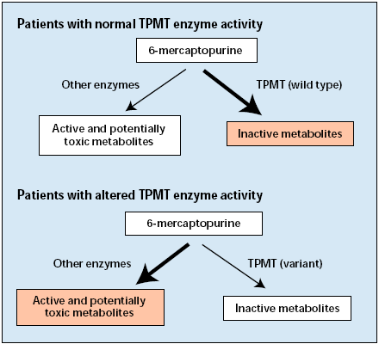
Who Gets Bone Marrow Suppression?
Thiopurine S-methyltransferase (TPMT) determines susceptibility to life-threatening bone marrow suppression
Approximately 0.1%- 10% of the population is homozygous for some form of variant
See ↑ accumulation and toxicity

Slide 50
Immunosuppressants
UC and CD
Achieve and maintain remission in moderate to severe disease
“Steroid sparing”
Use in patients unable to tolerate steroid taper or discontinuation
Takes several weeks to months to see the full benefit of these agents
They are often started with steroids and continued as steroids are tapered off
Commonly used in combination

Slide 51
Immunosuppressants
Methotrexate
Used for induction and maintenance of remission in Crohn’s disease
Not used in UC
Utilized in patients refractory/intolerant to AZA or 6-MP, “steroid-sparing” therapy
15-25 mg IM/SQ weekly (po absorption variable)
Time to onset: several weeks
Adverse effects
Common: N/V/D, stomatitis
Rare: hepatotoxicity, pneumonitis

Slide 52
Immunosuppressants
Cyclosporine
Salvage therapy in ulcerative colitis; no benefit in Crohn’s disease
Used in refractory colitis in patients facing colectomy, usually bridged to 6-MP or AZA
82% of patients able to avoid colectomy
IV 2-4 mg/kg/day; PO 5-6 mg/kg/day; x 3-6 months
Adverse effects
Common: paresthesias, HTN, headache, ↑ LFTs, ↑ K
Rare: nephrotoxicity, infection, seizure

Slide 53
Antimicrobials
Metronidazole has been most commonly used and studied
Efficacy in active Crohn’s disease, particularly involving the perianal area or fistulas
May be effective for inducing remission
Addition or substitution of ciprofloxacin may be beneficial, but only small trials have evaluated efficacy
No benefit has been demonstrated in UC
Lichtenstein GR. Am J Gastroenterol 2009;104:465-83.

Slide 54
Anti-TNFα Therapies
Infliximab (Remicade®)
Chimeric monoclonal anti TNF antibody
Induction: 5mg/kg @ weeks 0, 2 and 6
Maintenance: 5mg/kg q 8 weeks
Considered first line among the anti-TNF & biological therapies
Time to response: rapid (several days)
Up to 80% response in conventional therapy failures (Lancet 2002)

Slide 55
Anti-TNFα Therapies
Other biologic agents:
Adalimumab (Humira®):
Moderate/severe CD and UC; 46% final remission rate (Annals IM 2007)
Natalizumab (Tysabri®):
Moderate/severe CD; BBW for progressive multifocal leukoencephalopathy [PML]
Certolizumab (Cimzia®):
Moderate/severe CD; CRP > 10 = best response (NEJM 2007)
May be useful in patients who have lost response to infliximab due to antibody development

Slide 56
Anti-TNFα Therapies
Mechanism of action
Monoclonal antibody that binds TNF-α inhibiting inflammatory effects in the GIT
Adverse effects
Common: serum-sickness (delayed infusion reaction)
Rare: hypersensitivity, infusion rxns, reactivation of tuberculosis, reactivation of Hep B, infection, sepsis, lymphoma
TB/HepB screening REQUIRED before start of therapy

Slide 57
Anti-TNFα Therapies: ADR Prevention
Prevention of infusion reactions
Prior to infusion: corticosteroids + antihistamine
Treatment of infusion reactions
Slow/stop infusion
Corticosteroids (acute and delayed reactions)
Antihistamines (acute and delayed reactions)
Acetaminophen (delayed reactions)
Infusion reactions reduced with concomitant administration of immunomodulators

Slide 58
Anti-TNFα Therapies
Place in Therapy: UC
Place in Therapy: CD
Infliximab, adalimumab only
Moderate to severe UC refractory to 5-ASA, corticosteroids, immunomodulators
Effective for induction and maintenance of remission
Moderate to severe CD refractory to 5-ASA, corticosteroids, immunomodulators
Up to 81% response
Effective for induction and maintenance of remission, in treating/healing fistulizing CD
Up to 45% response at 30 weeks
Use with AZA, 6-MP, MTX
Podolsky DK. NEJM 2002; 347(6):417-429.

Slide 59
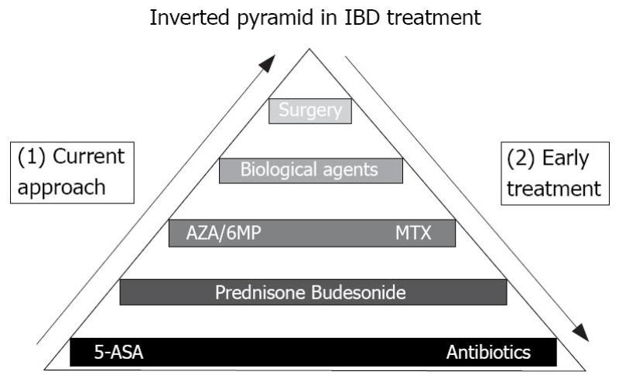
Use of the “Top-Down Approach”
Old versus New Approach
Advanced Thinking in 2013…
World J Gastroenterol 2008;14(36):5512-18.
European data suggests going “top-down” may be more beneficial in long run
Caveats:
50% of patients never need steroids (con)
Cost a huge issue (con)
Patients on anti-TNFα agents have higher QOL, ↓ ER visits (pro)
Papa A. Eur Review 2009; 13(1): 33-35. D’Haens G. Lancet 2008; 371: 660-67.

Slide 60
Case
JP is a 30 year-old man that has been recently diagnosed with Crohn’s disease. He is currently in the hospital secondary to severe abdominal pain, N/V and significant weight loss secondary to his Crohn’s disease.
Imaging studies found multiple areas of cobblestone appearance in the terminal ileum and colon.

Slide 61
Case Answers
Severity of disease?
Agents to be used?
Timing of dosing?

Slide 62
Summary
CD and UC both challenging diseases to treat
Treat aggressively and early
This may decrease hospital stay, ER visits, and keep patients’ ADLs at high level
Goals:
Keep patient from exacerbating
Consider best MOAs and dosage forms
Monitor tightly (especially with newer agents)

Slide 63
Long-Term Management of IBD: A Summary
Variable | Rectal/Distal UC | Extensive UC | Crohn’s Disease
Mild Disease | PO/PR 5-ASA derivatives PR corticosteroid | PO 5-ASA derivatives | PO 5-ASA derivatives Budesonide
Moderate Disease | PO/PR 5-ASA derivatives PR corticosteroid | PO 5-ASA derivatives | PO corticosteroids AZA or 6-MP
Severe Disease | PO/IV/PR corticosteroids | PO/IV corticosteroids ??? Cyclosporine | PO/IV corticosteroids MTX or IV Infliximab
Refractory Disease | PO corticosteroids + AZA or 6-MP | PO corticosteroids + AZA or 6-MP Infliximab | IV Infliximab MTX
Perianal or Fistulizing Disease | --- | --- | Metronidazole +/- Ciprofloxacin IV Infliximab AZA or 6-MP
Remission | PO/PR 5-ASA derivatives AZA or 6-MP | PO/PR 5-ASA derivatives AZA or 6-MP Infliximab | PO 5-ASA derivatives AZA or 6-MP Infliximab

Slide 64
Questions?

